Slide 1

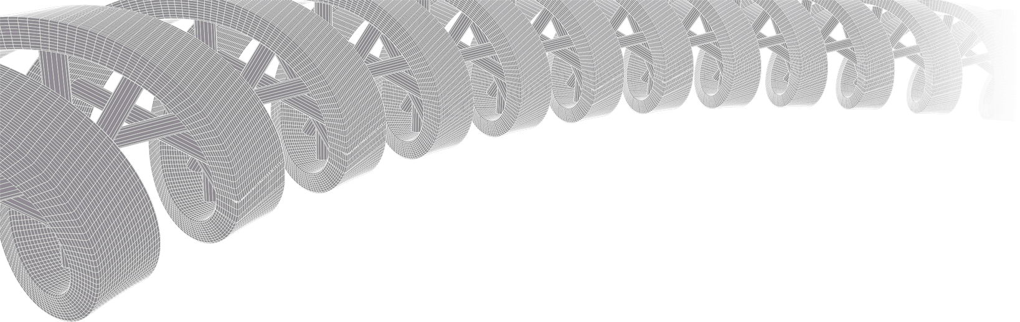

PMBIO Module 07 Clinical. Clinical Applications
Malachi Griffith, Obi Griffith, Zachary Skidmore, Huiming Xia
Introduction to bioinformatics for DNA and RNA sequence analysis (IBDR01)
29 October – 2 November, 2018
Glasgow

Slide 2
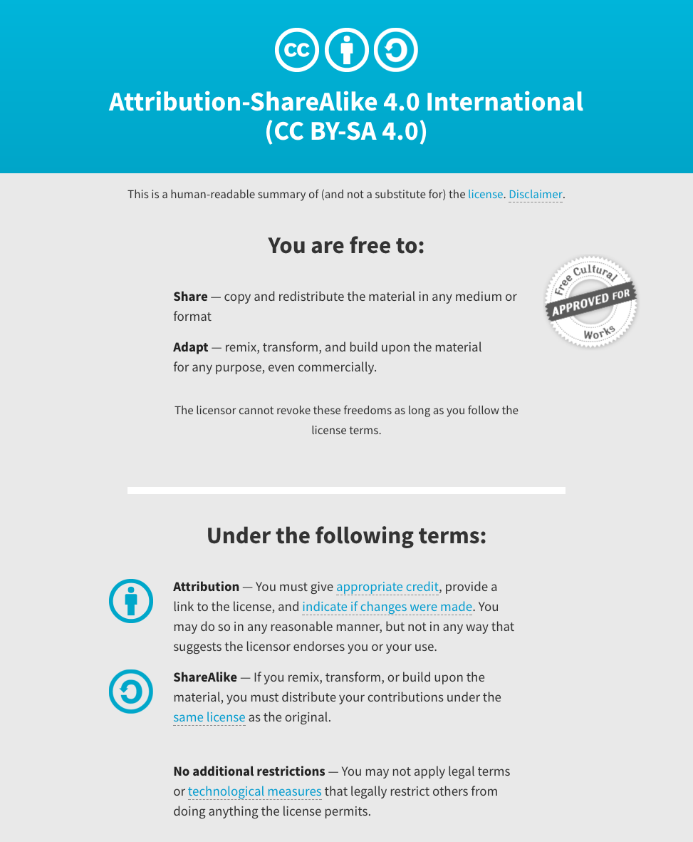
Notes:
Note there are two licenses if effect for this course.
All *content* (lectures, written materials, etc.) are made available under the Creative Commons Attribution-ShareAlike 4.0 International (CC BY-SA 4.0). (https://creativecommons.org/licenses/by-sa/4.0/).
All *code* (R scripts the website code itself) are made available under the MIT License (https://opensource.org/licenses/MIT).

Slide 3
Learning objectives of module 07: Clinical
Key concepts: Clinical interpretation of variants, variant interpretation types (predisposing, predictive, predisposing, diagnostic), variant interpretation guidelines, clinical applications of passenger somatic variants (early detection, minimal residual disease tracking, personalized vaccines).
Prioritize germline variants to identify putative de novo and clinically relevant mutations
Germline pathogenicity assessment (demonstrate concepts with some example variants using ClinGen Variant Curation Interface)
Biological function or oncogenicity (demonstrate concepts by uploading a filtered VCF into CRAVAT)
Somatic clinical actionability (demonstrate concepts with some example variants using CIViC)

Slide 4
Strategies to bring genomics information to bear for as many cancer patients as possible
Precision medicine targeting of driver mutations
Leveraging passenger variants
Tracking minimal residual disease
Identifying neoepitopes
Predicting response to immunotherapy
Developing personalized vaccines

Slide 5
Precision medicine targeting of driver mutations
1980s: Development of Targeted Therapies
2000: Human Genome Sequencing Project
2001: FDA Approval for Imatinib in BCR-ABL1 CML
2014: FDA Approval for BRCA Testing
2017: FDA Approval of Pembro for MSI tumors
BRAF -> V600E -> Melanoma -> Predictive -> Vemurafenib
ERBB2 -> Amplification -> Breast -> Predictive -> Traztuzumab
EGFR -> L858R -> Lung -> Predictive -> Erlotinib
ALK -> Fusions -> Lung -> Predictive -> Crizotinib
EWSR1-FLI1 -> Fusions -> Ewing Sarcoma -> Diagnostic
DNAJB1-PRKACA -> Fusions -> flHCC -> Diagnostic
VHL -> Loss of function mutations -> Kidney -> Predisposing
… an increasingly long tail of rare but clinically relevant variants
Erica Barnell
Notes:
Notes on examples:
BRAF -> V600E -> Melanoma -> predictive?
EGFR -> L858R -> Lung -> predictive?
EGFR -> T790M -> Lung -> predictive?
ALK -> Fusions -> Lung -> predictive?
ERBB2 -> Amplification -> Breast -> predictive?
EWSR1-FLI1 -> Fusion -> Ewing Sarcome -> Diagnostic?
Secondary mutations in BCR-ABL1 that confer resistance?
PTEN Loss perhaps?
I would argue BRCA mutations should also be counted. Also, we are at the point where ER/PR/HER2/KI67 testing by RNA is cheaper and more accurate than IHC and really *should* be the clinical standard. Rolling out in less developed countries that don't have legacy dependency on IHC. NTRK fusions and inhibitors seem likely to have a wide impact
ERBB2 kinase domain mutations in breast cancer, while rare, are clearly clinically relevant
KIT mutations in GIST and some other tumors guide standard of care
There's about a dozen genes with mutations that inform FDA approved treatments and guidelines according to oncokb. Not as many as we would like but to say CML is the only example is really weird
I think the problem is that many of these are not being run routinely in the clinical setting outside of select academic hospital settings. But this is more a problem with slow/conservative clinical adoption and default resistance of insurance providers. It will take a few more years beating them over the heads with data. OHSU is planning to roll BRCA testing out to all patients in their system (hundreds of thousands or millions planned). Mary Claire King has been preaching this for years but think about how long we've known (or could impute) of the importance/value of this. Things just move show.
MSI -> nsclc -> nivolimab
Dnajb1-prkaca -> flHCC -> diagnostic
BTK -> C421 -> CLL -> predictive of resistance
Special subset of heme malignancies are defined by eosinophilia and pdgfra/b and one other gene.
Alk fusions are highly targetable.
Her2 targeting with trastuzumab changed the picture for these patients as far as I understand. Both of these are heavily represented in CIViC, and played a large role in MATCH basket trial. The data seems very much there in some of these trials, so it should only be a matter of time for it to be more accepted.
I noted the MSI (non gene entity) example, and think we should perhaps prioritize non gene entities a bit higher in our upcoming goals.
In general the variant clinical interpretations should help us address this topic more effectively. Maybe 5 years from now someone asking that same question could be directed to CIViC as part of the answer.
Prosigna (Produced by Nanostring) is a panel of ~50 RNA transcripts that predicts breast caner recurrence and is now included in international guidelines for breast cancer surveillance
Veracyte produces a bunch of genomic diagnostics including Afirma (Fine Needle Aspiration analysis to diagnose thyroid malignancy), Percepta (lung cancer diagnosis), and Envisia (IPF diagnosis)

Slide 6
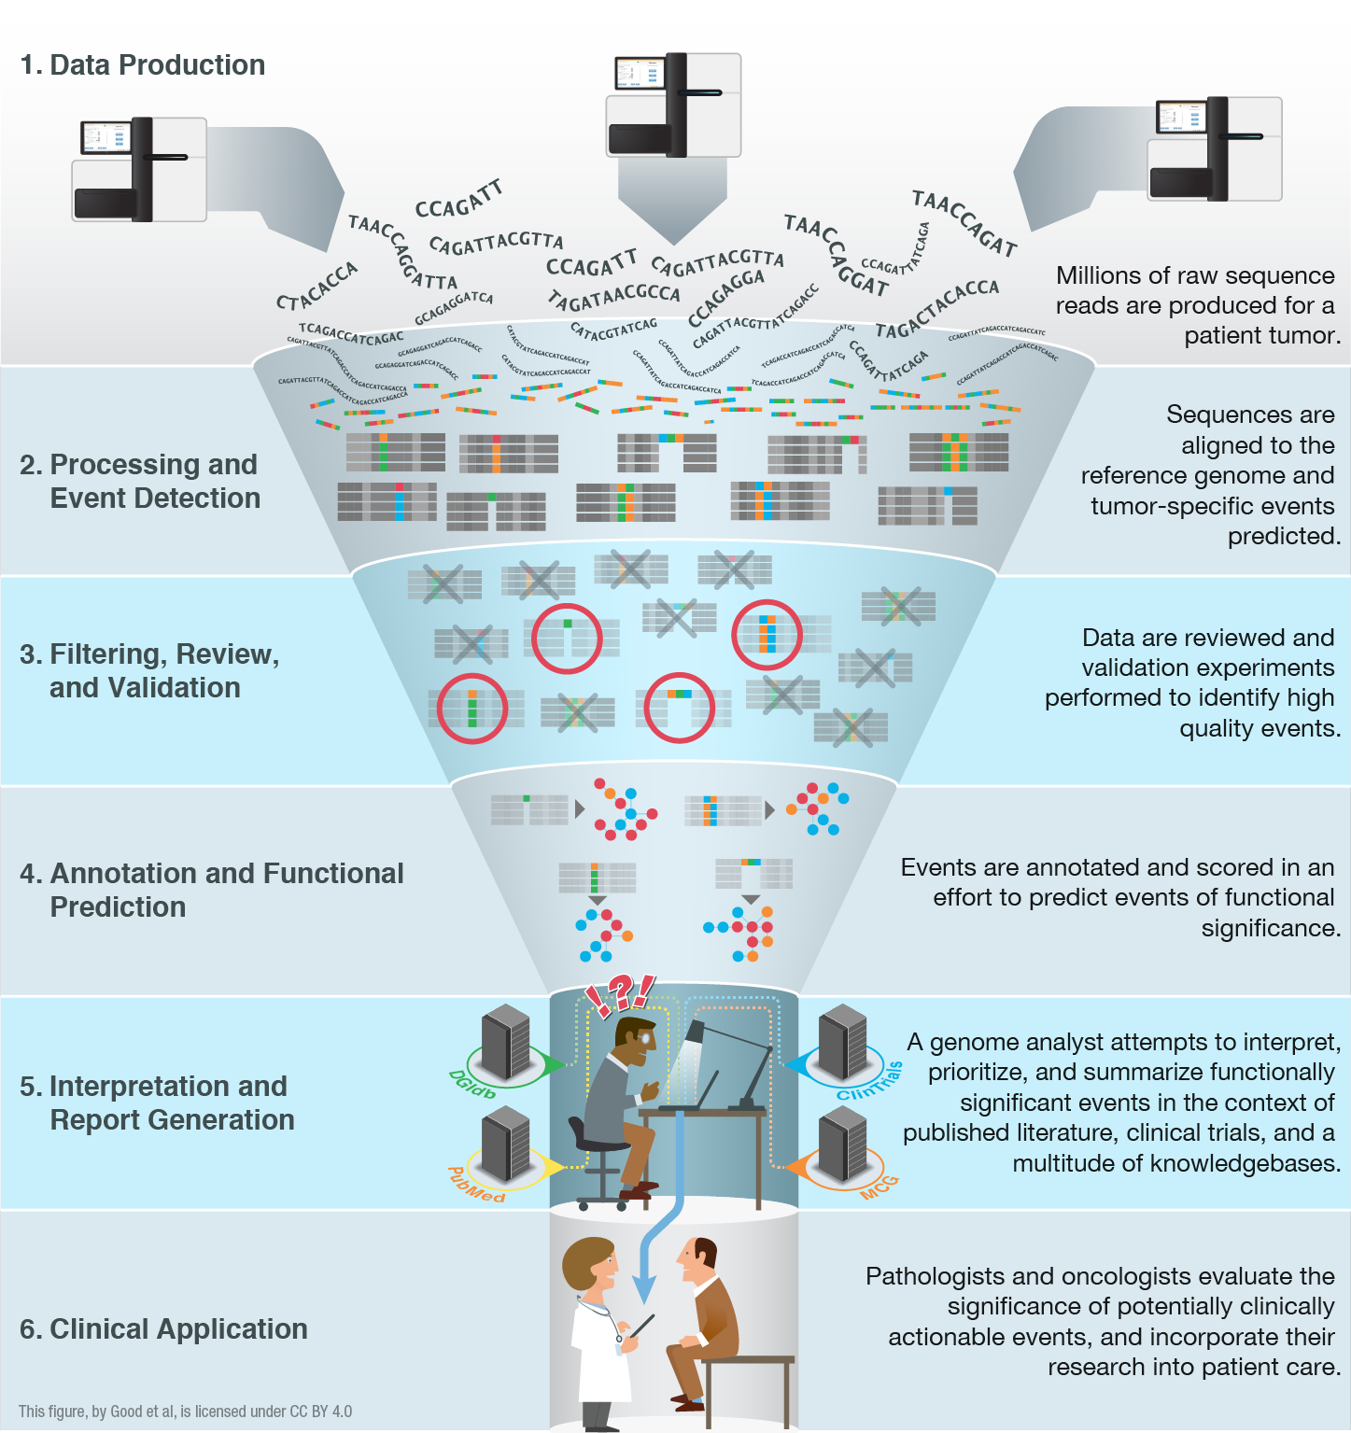
Problem: Clinical interpretation of genomic alterations remains a major bottleneck for realizing precision medicine
Joshua McMichael
Good BM, Ainscough BJ, McMichael JF, Su AI†, Griffith OL†. 2014. Genome Biology. 15(8):438.
Notes:
We have an embarrassment of riches with all of the –omic events now being detected (though there is plenty of room for improvement!).
We are starting to have a handle on doing this routinely and quickly. We can generate the raw data, feed it into automated pipelines that process the data and predict genomic events. Filtering, review and validation thins these lists down to somewhat tractable counts of 10s to 100s of events. Where we are really stuck now is at the interpretation and report generation stage. This is a major bottleneck. The ‘genome analysts’ who have the skill sets to assemble final reports that a clinician might find useful are completely swamped.
One way to address this I already talked about. Education. We can train more of these genomics experts. But we also need to harness informatics strategies to make their job easier and address the bottleneck. With that in mind we are pursuing various data mining, crowd sourcing, natural language processing, etc.

Slide 7
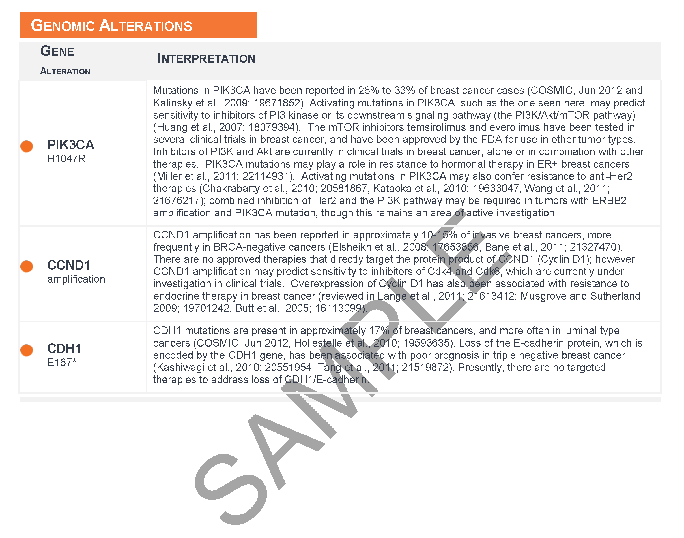
Clinical interpretations of variants are currently created in information silos with limited use of standards and poor interoperability
Interpretations are typically produced by paid curators with no provenance and no mechanism for feedback
Interpretations are stored in hundreds of private databases
This effort would be enhanced by an open public domain effort
Notes:
Thankfully, there are services available that will interpret your samples for you. However, these interpretations are not freely and openly accessible. You can pay to have your sample annotated, but you cannot learn much more than the paragraph that is sent back in your results file. Not only that, but you can only learn about variants that happened to be found in your case, and the interpretations that are given are not all that transparent, or receptive to feedback.
This particular example is from a Foundation Medicine report.

Slide 8
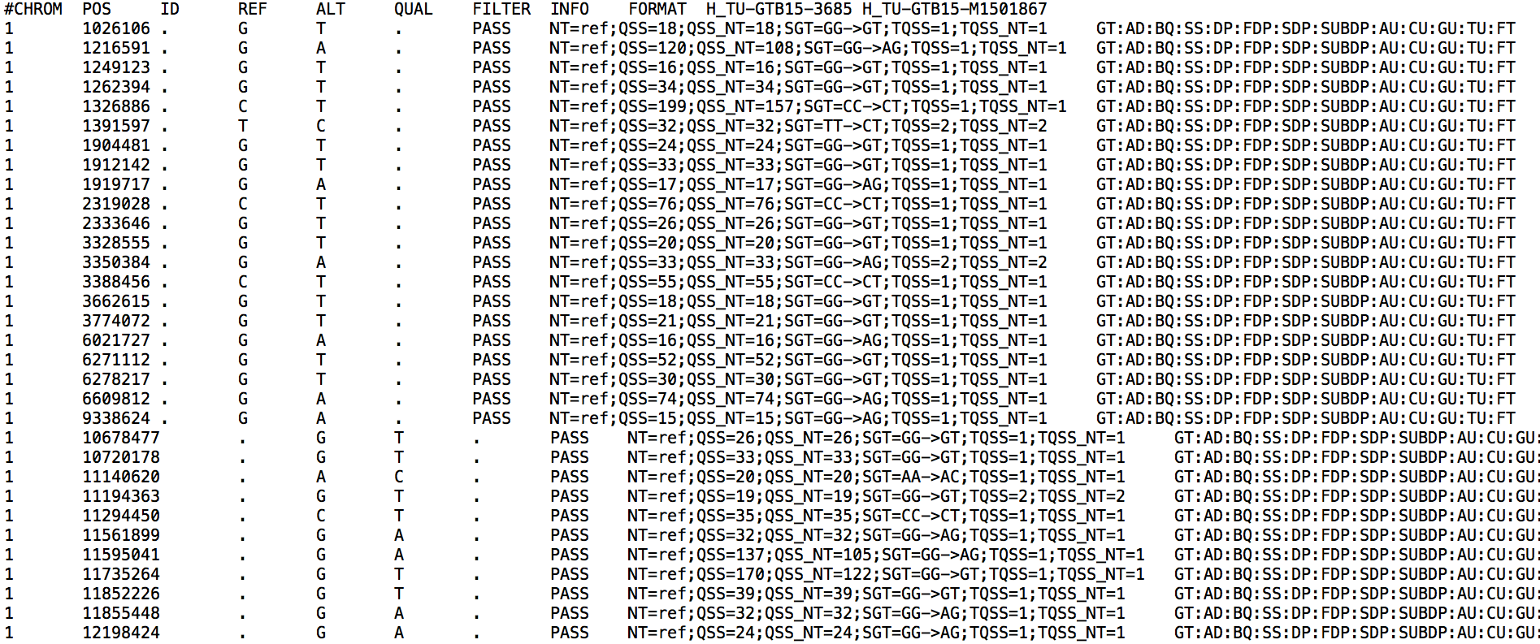
Variant analysis/interpretation starts with a raw variant list (VCF file)
Details of the VCF file format: hts-specs, VCF-v4.2.pdf

Slide 9
How do we interpret these variants?

Slide 10
Important concepts in the interpretation of variants
False positives vs. true positives
Somatic mutation vs. germline mutation vs. germline polymorphism
Gain-of-function (activating) vs. loss-of-function (inactivating)
Deleterious vs. tolerated
Recurrent vs. random
Driver vs. passenger
Dominant clone vs. sub-clonal
Regulatory vs. coding
Relevant to cancer biology
‘canonical’ variants, ‘hotspot’ variants, ‘cancer genes’
Clinically relevant / ‘actionable’
‘Druggable’
Predictive, prognostic, diagnostic, predisposing
Notes:
Many of these terms are often used in

Slide 11
Somatic mutation vs. germline mutation vs. germline polymorphism
Somatic mutations are best distinguished by adequate sequencing of a matched normal
Affected and unaffected family members may help to determine origin of a germline mutation
Comparison of variants to variant databases can also help to classify variants as:
Germline polymorphisms
1000 genomes
Exome sequencing project (~6,500 individuals)
ExAC, Exome Aggregation Consortium (~60,000 individuals)
gnomAD browser (123,136 WXS and 15,496 WGS)
Germline mutations
OMIM, HGMD, PharmGKB, ClinVar
ACMG guidelines
Gemini
Somatic mutations
By inference if the mutation is not a common polymorphism (often a weak inference) or is a classic hotspot mutation

Slide 12
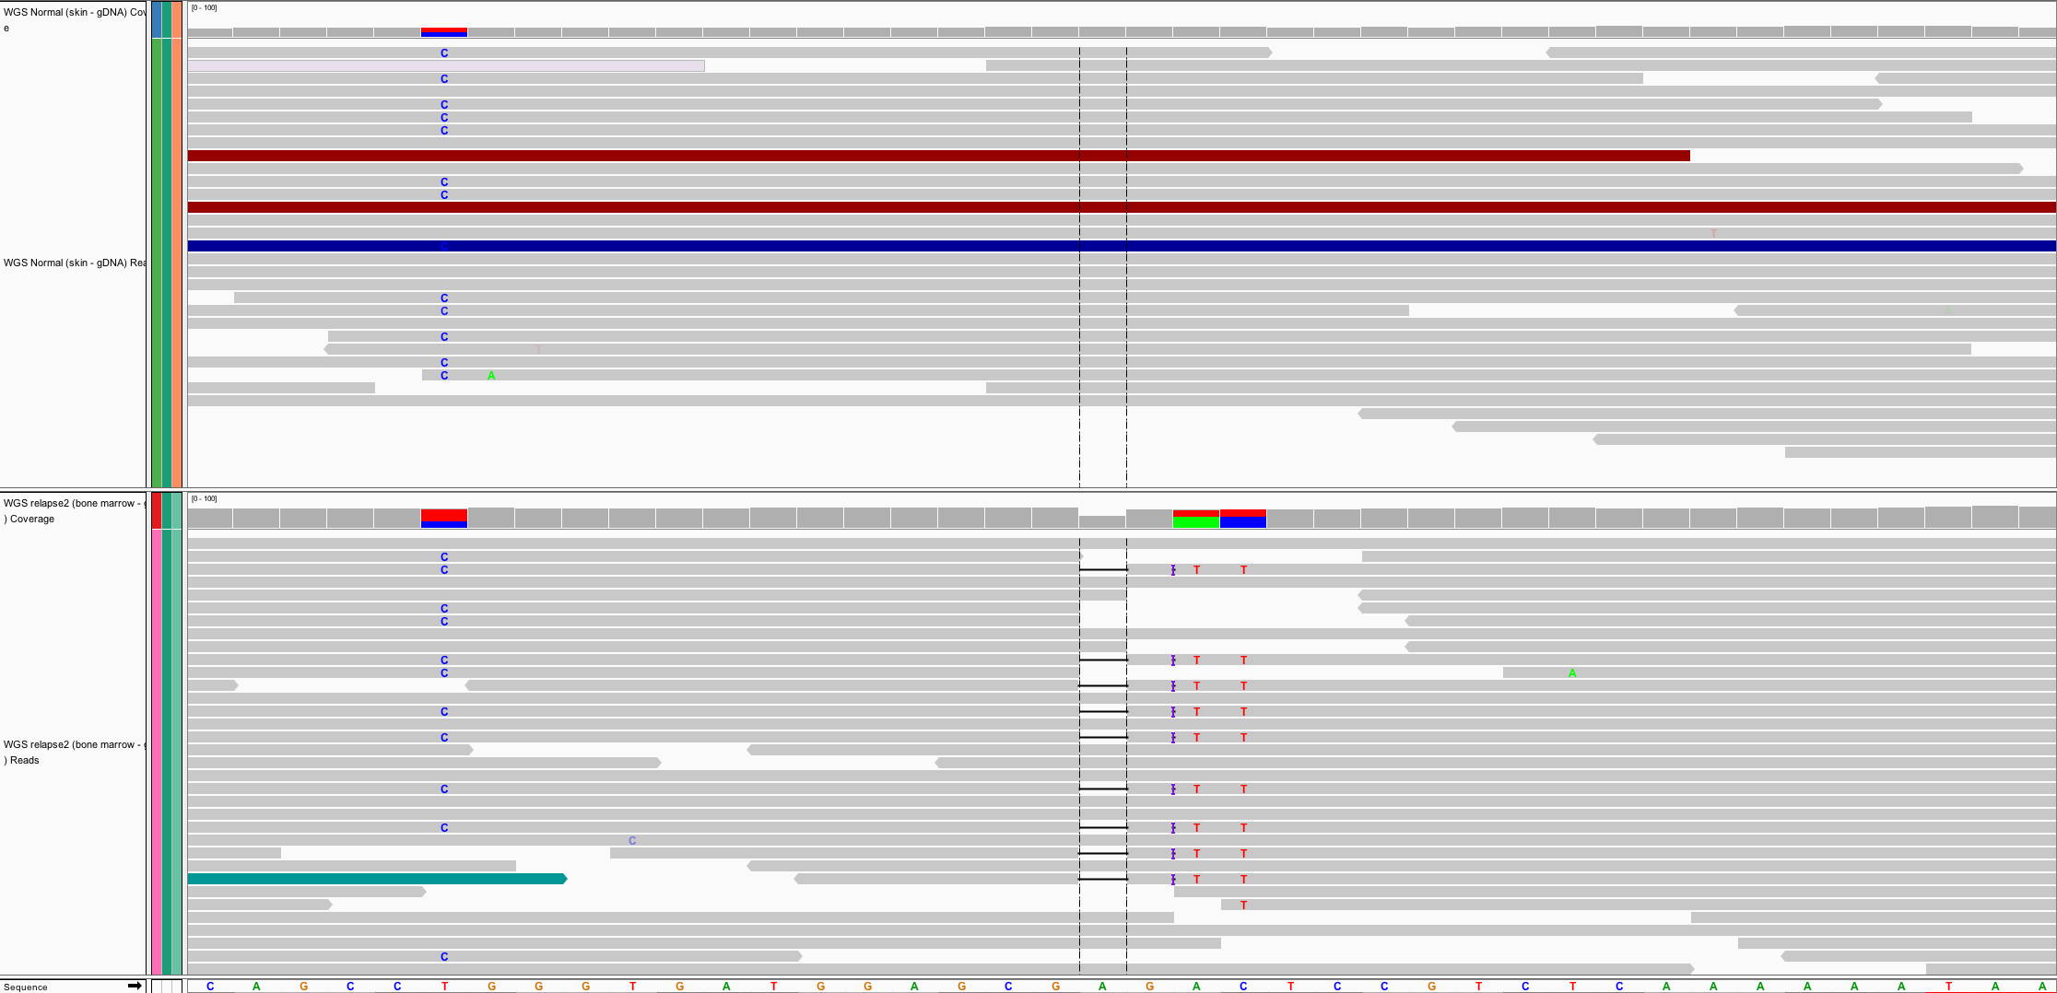
Somatic versus germline demonstration
Germline mutations
Present in egg or sperm
All cells of affected offspring
Heritable
Cause of familial cancers
Somatic mutations
Occur in non-germline tissues
Only tumor cells (breast, lung, blood, etc.)
Non-heritable
Cause of sporadic cancers
Normal
Tumor
Germline
Somatic

Slide 13
False positives
Use IGV to examine alignments for artifacts
Use an intersection of variant callers
“panel of normals” analysis
Useful resources
Discussion of variant callers
Optimizing tumor genome analysis
Hands-on IGV tutorial

Slide 14
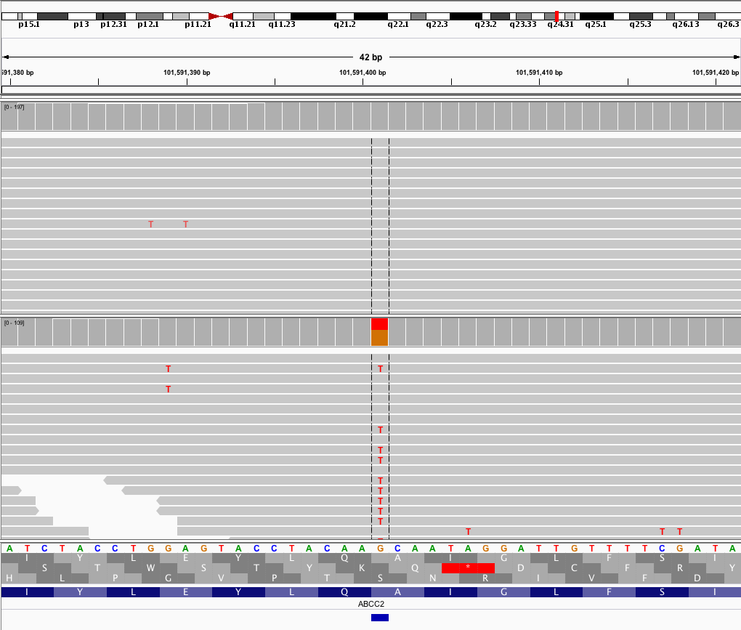
Example of a high quality somatic variant
Normal
Tumor
This G/T variant was independently called by 5 somatic variant callers

Slide 15
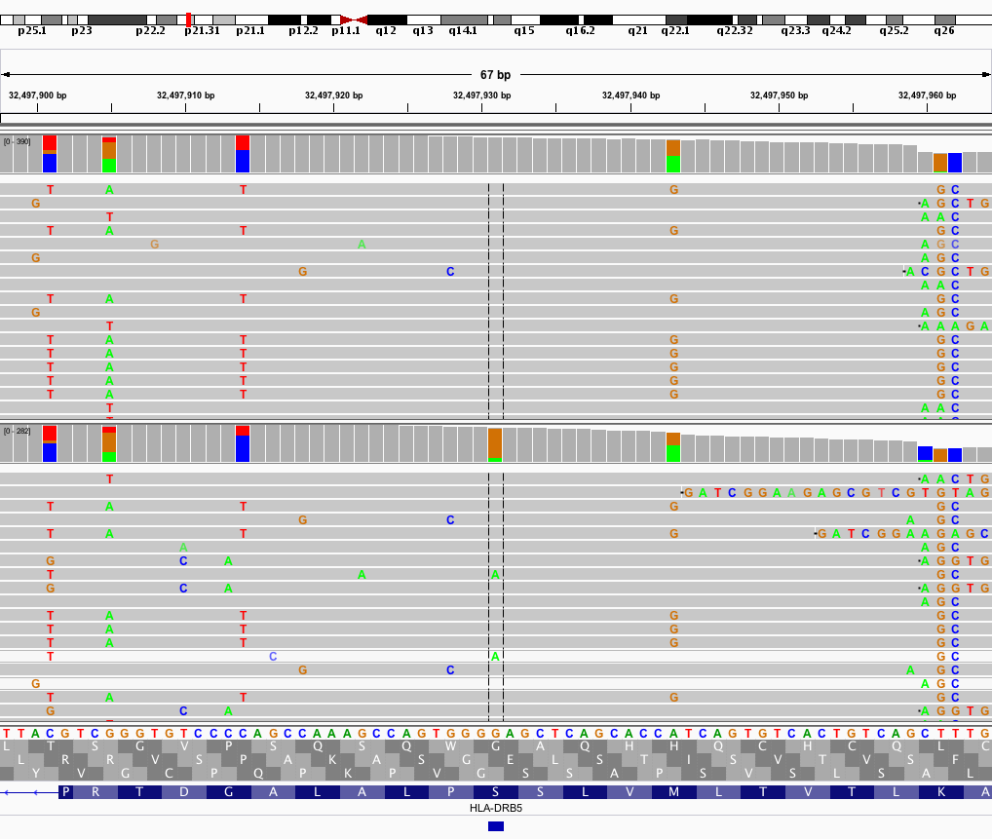
Example of a low quality somatic variant
Normal
Tumor
This G/A variant was called by only 1 of 5 somatic variant callers

Slide 16
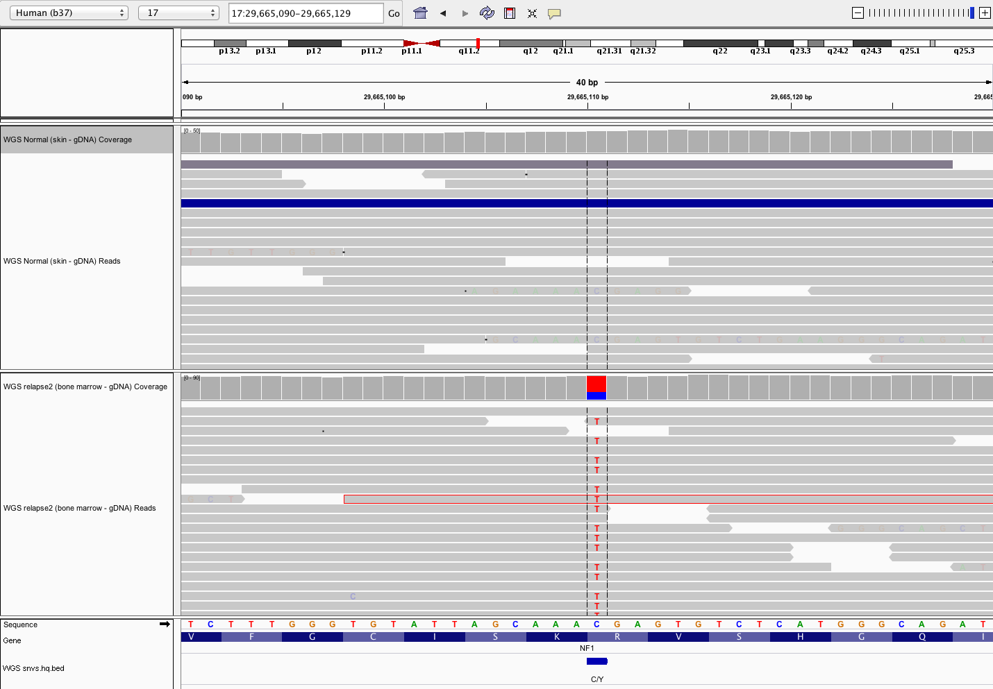
Variant allele frequency (VAF)
VAF = Variant reads / Total reads
Normal
VAF = 0/20 = 0%
Tumor
VAF = 14/20 = 70%
A heterozygous variant is expected to have VAF = 50%. Often not true due to sample purity, tumor heterogeneity, sampling error, alignment issues, copy number variation, etc.

Slide 17
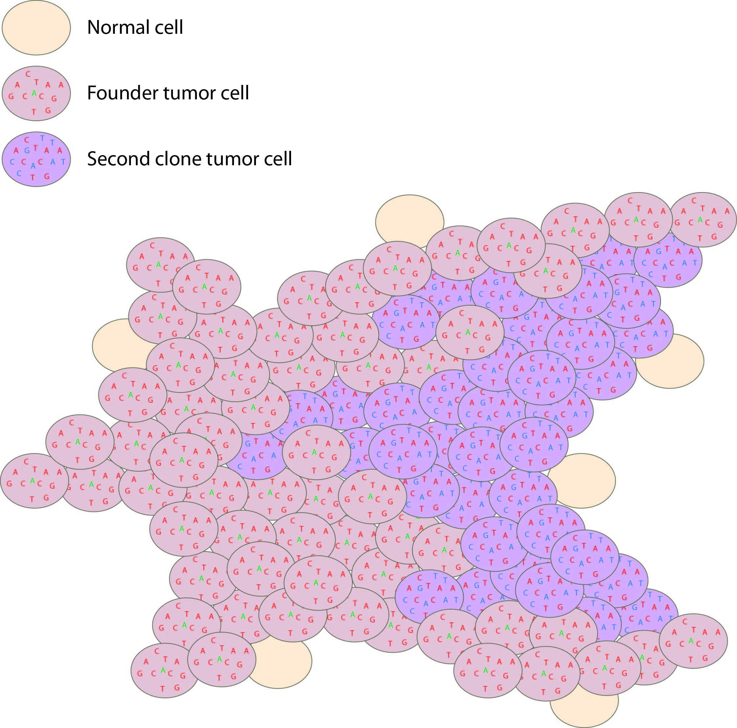
Dominant clone vs. sub-clonal (and driver vs. passenger)
Tumor variant allele frequency
Proportion
NF1
Read coverage (X)
WGS data
Tumor variant allele frequency
Tumor variant allele frequency

Slide 18
Gain-of-function vs. Loss-of-function
Gain-of-function and loss-of-function generally refer to a change in specific function of a gene product (protein or RNA) leading to a phenotypic effect
Loss-of-function implies that a normal gene function is no longer possible
Many random mutations can lead to inactivation
Manifests in mutation data as scattered across the length of the gene and may be frameshift, nonsense, and splice site mutations
Gain-of-function implies an increased or new gene function
There are far fewer ways to create an activating mutation
These tend to have dominant phenotypes
Manifest in mutation data as “hotspots”
Usually missense mutations
The pattern of *recurrence* can be a powerful hint for distinguishing activating vs. inactivating mutations.

Slide 19
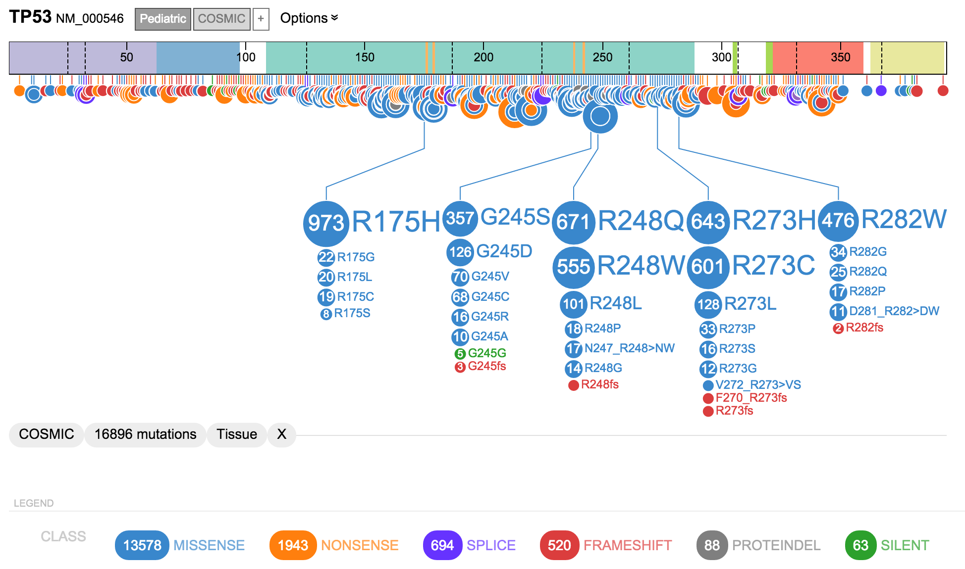
Gain-of-function vs. Loss-of-function
TP53: Recurrence pattern and mutation types suggest loss-of-function

Slide 20
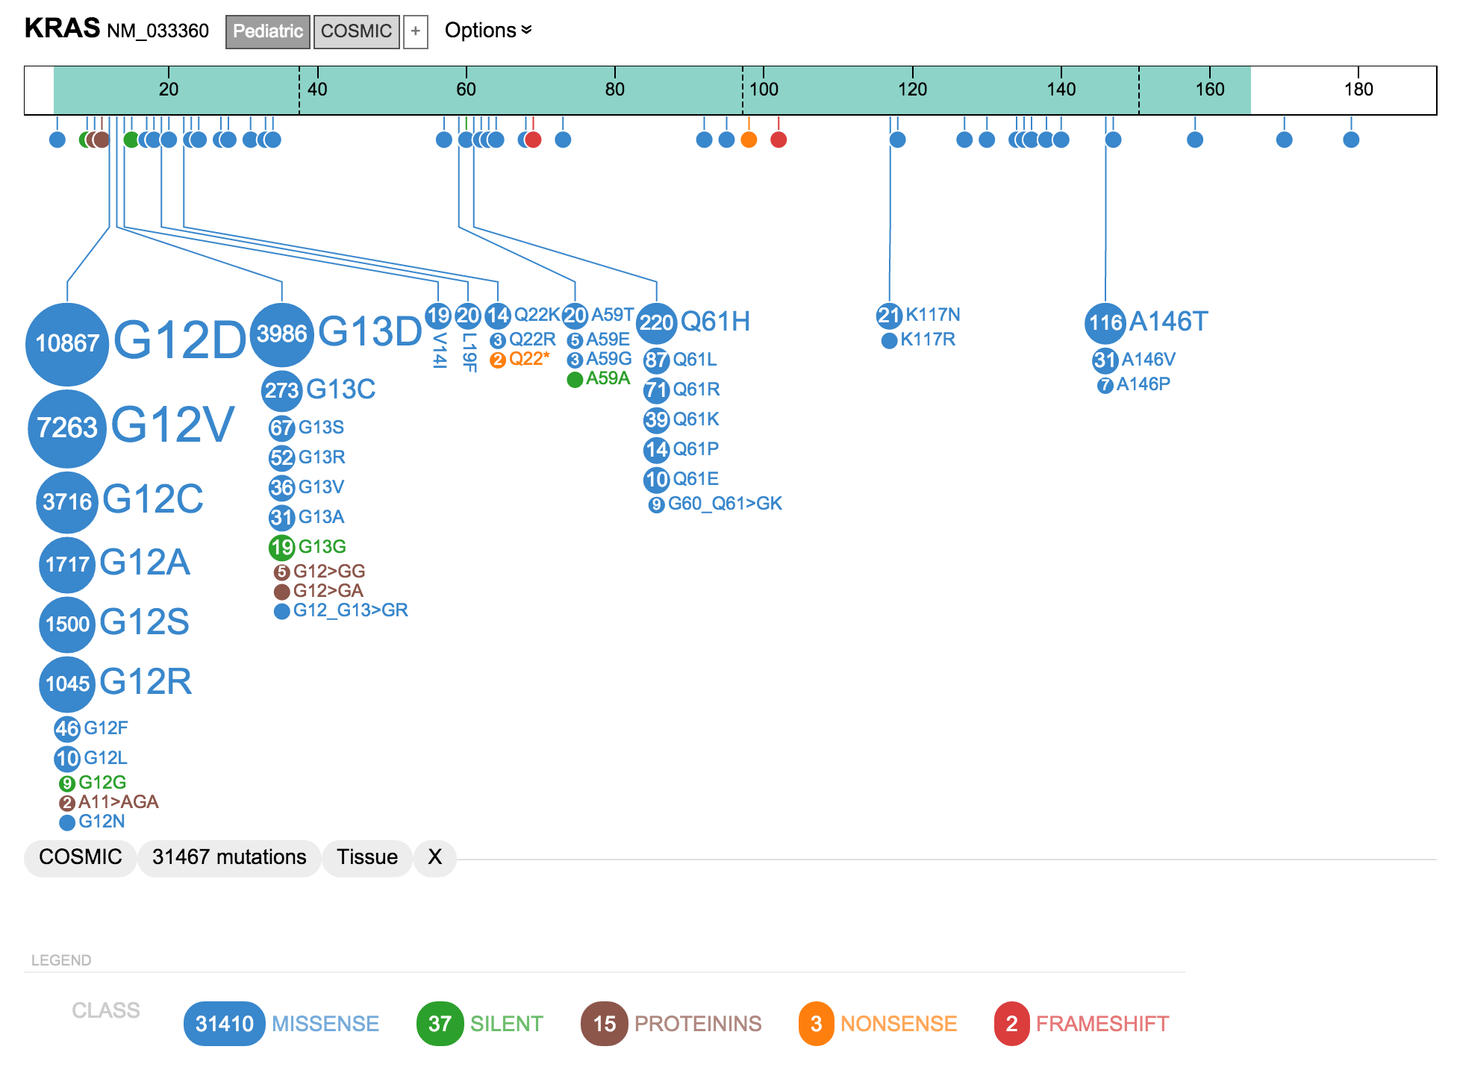
Gain-of-function vs. Loss-of-function
KRAS: Recurrence pattern and mutation types suggest gain-of-function

Slide 21
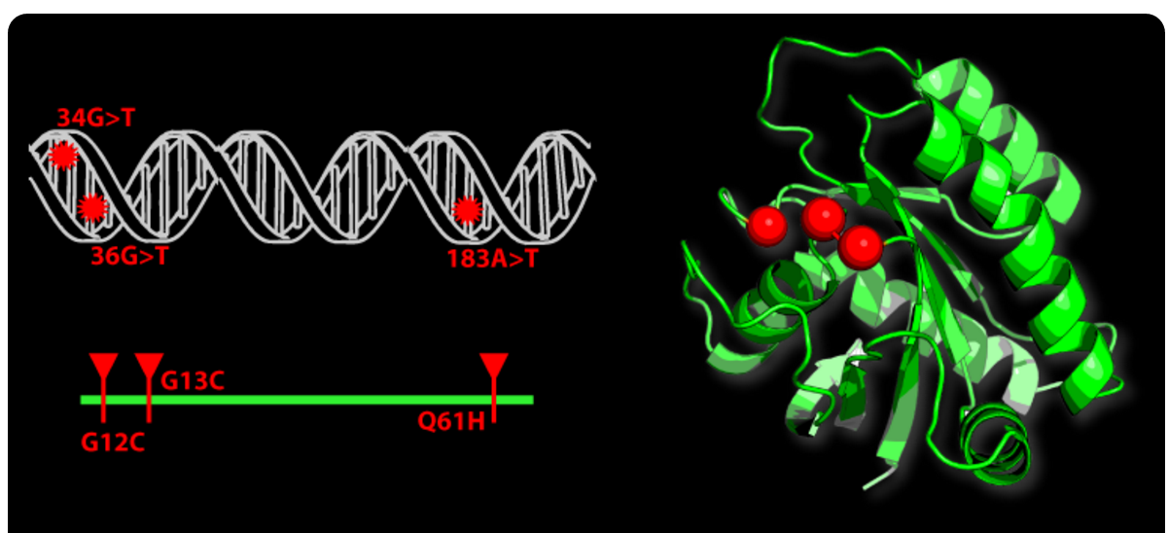
Gain-of-function “hotspots” may be missed in 2D but seen in 3D models of protein structure
From: Mutation3D website.
For a more detailed discussion of relevant tools: Finding Mutation Hotspot At Level Of Amino Acid By Spatial Proximity In Protein Structures

Slide 22
Recurrent vs. random/background mutation
Recurrent mutation of a gene or pathway can imply functional relevance of that gene/pathway
Particular somatic mutations that are recurrent (e.g. BRAF V600E) can imply an activating mutation
One of the most basic (but fruitful) goals of large scale tumor genome sequencing projects has been to look for these patterns of recurrence
Since random/background mutation rates can be very high in some tumors, determining whether an observed level/pattern of recurrence is significant is important
Overall mutation burden, gene size, pathway size, systematic artifacts, and other factors complicate this goal

Slide 23
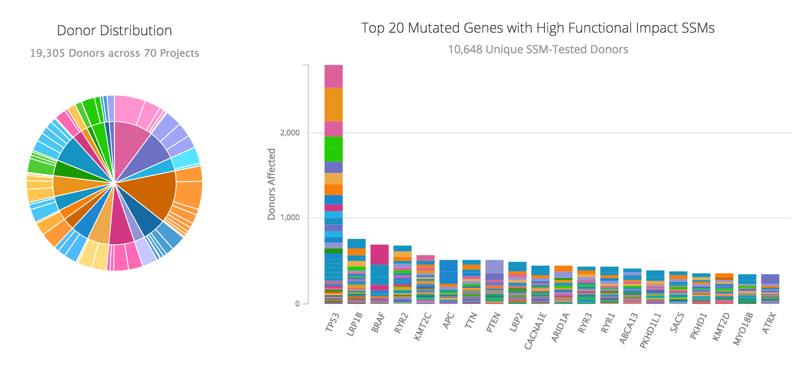
So far, TCGA and ICGC have sequenced 1000s of exomes, 100s of whole genomes, and surveyed the landscape of mutated genes for 40 cancer types
https://dcc.icgc.org/

Slide 24
Exploring cancer mutation data portals
Many, many resources
Some of the resources that we find most useful
Genomic data commons
ICGC data portal
cBioPortal (OncoPrinter & MutationMapper)
Cosmic
TCGA data portal
St. Jude pediatric cancer portal (ProteinPaint)
We track (blog about) these resources as they develop (on BioStars here).

Slide 25
A ‘waterfall’ plot is one way to visualize the pattern of recurrence in a cohort
https://github.com/griffithlab/GenVisR

Slide 26
Deleterious vs. tolerated (functional vs. non-functional)
Many tools/resources attempt to classify variants as “deleterious” vs. “tolerated” (aka “benign”)
E.g. Sift, PolyPhen, Condel, CADD, etc.
The goal of these tools is often confused with predicting whether the mutation is gain-of-function/activating
Not the same thing…
Mostly driven by sequence conservation (though CADD considers a more complex set of features)
Variant effect annotators
VEP, snpEff, ANNOVAR, VAAST

Slide 27
Functional relevance to cancer biology?
Many useful resources that are gene centric
Databases of tumor suppressors and oncogenes
If the gene where a variant occurs is relevant to cancer, then we turn our attention to the significance of the specific variant
Does the variant have established functional relevance?
DoCM – the Database of Curated Mutations is a resource that aggregates specific variants with documented relevance to cancer

Slide 28

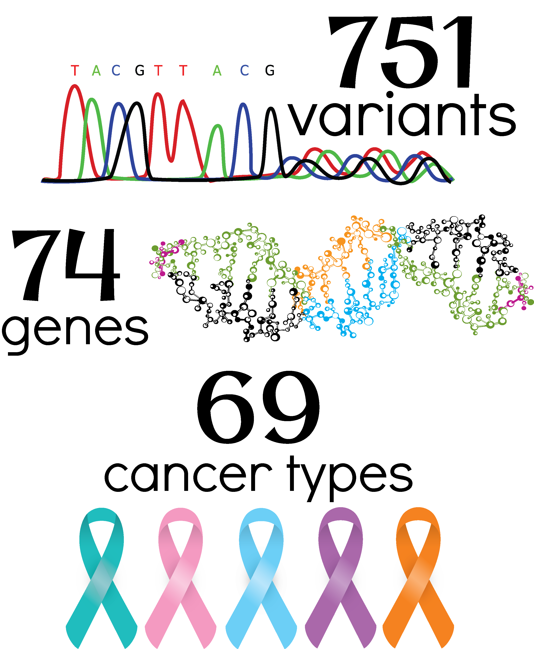
Criteria for inclusion
Confirmed to be recurrently mutated in one or more cancer types
Functional evidence
Studies elucidating function in cell lines/mouse models
http://docm.info
Notes:
So we created a database that has been curated to contain pathogenic mutations. It is easy to consume on the web at docm.info and integrate into computational pipelines with a application programming interface. A mutation is included in DoCM if it has clinical evidence such as a drug targets or diagnostic or prognostic associations with a particular mutation. The database of curated mutations currently contains 488 variants across 63 genes in 34 different cancer types.

Slide 29
Clinically relevant?
A gene or variant can be relevant to cancer biology but not have any established clinical relevance
Arguably this is mostly the case…
The majority of genes and variants when observed do not lead to a clinical action
Types of clinical relevance
Predictive (“druggable”)
Prognostic
Diagnostic
Predisposing

Slide 30
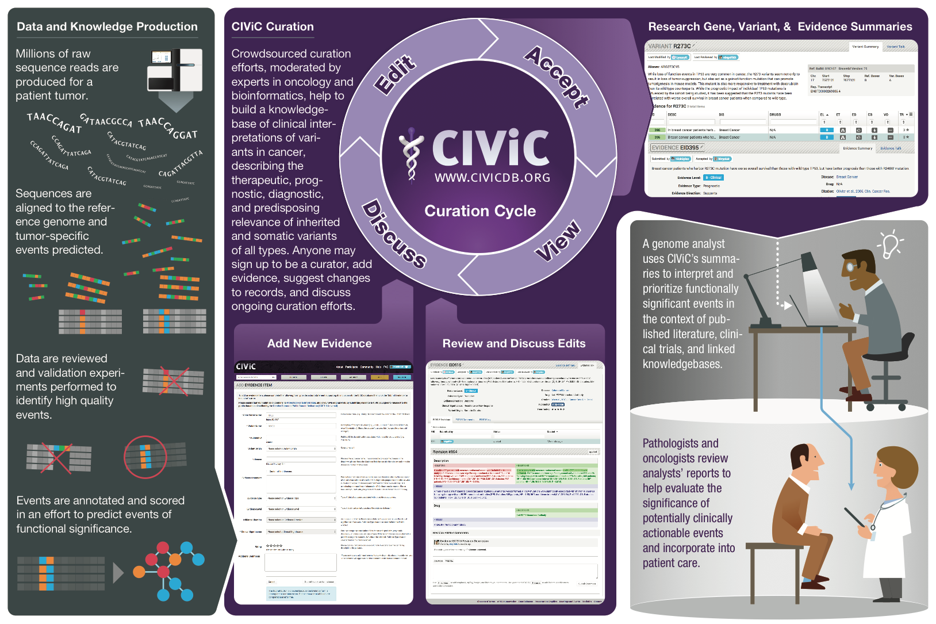
We created CIViC to address this need – an open knowledgebase and curation system for clinical interpretation of variants in cancer
www.civicdb.org
Joshua McMichael
Notes:
Goal: Create a resource that stores such interpretations, facilitates their creation, allows them to evolve rapidly (with provenance), and makes them publicly available for automated report generation

Slide 31
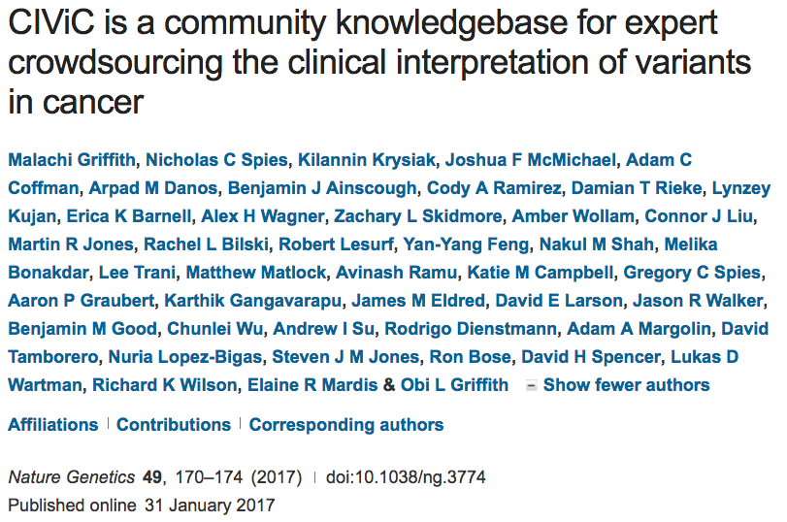

Slide 32
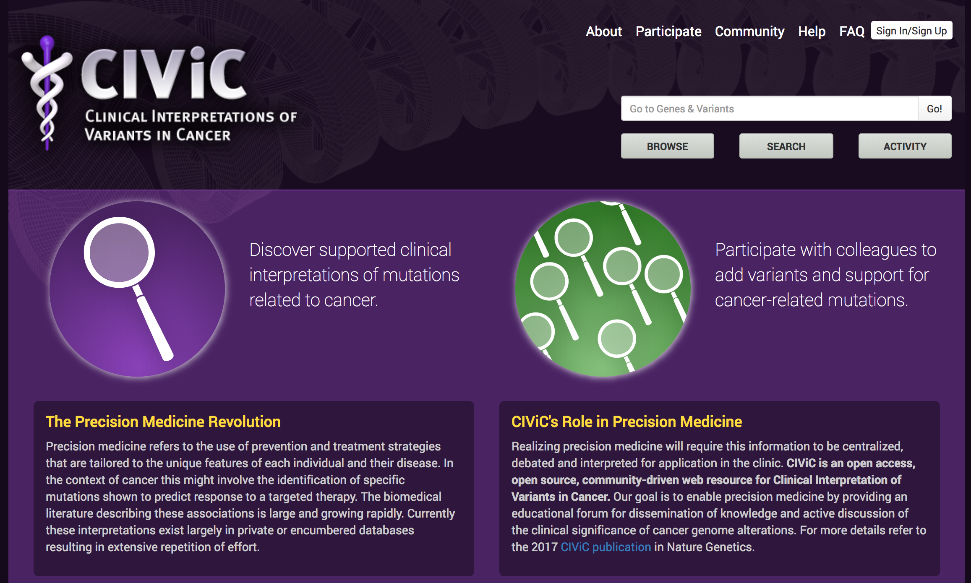
All content is freely available for all uses at www.civicdb.org

Slide 33
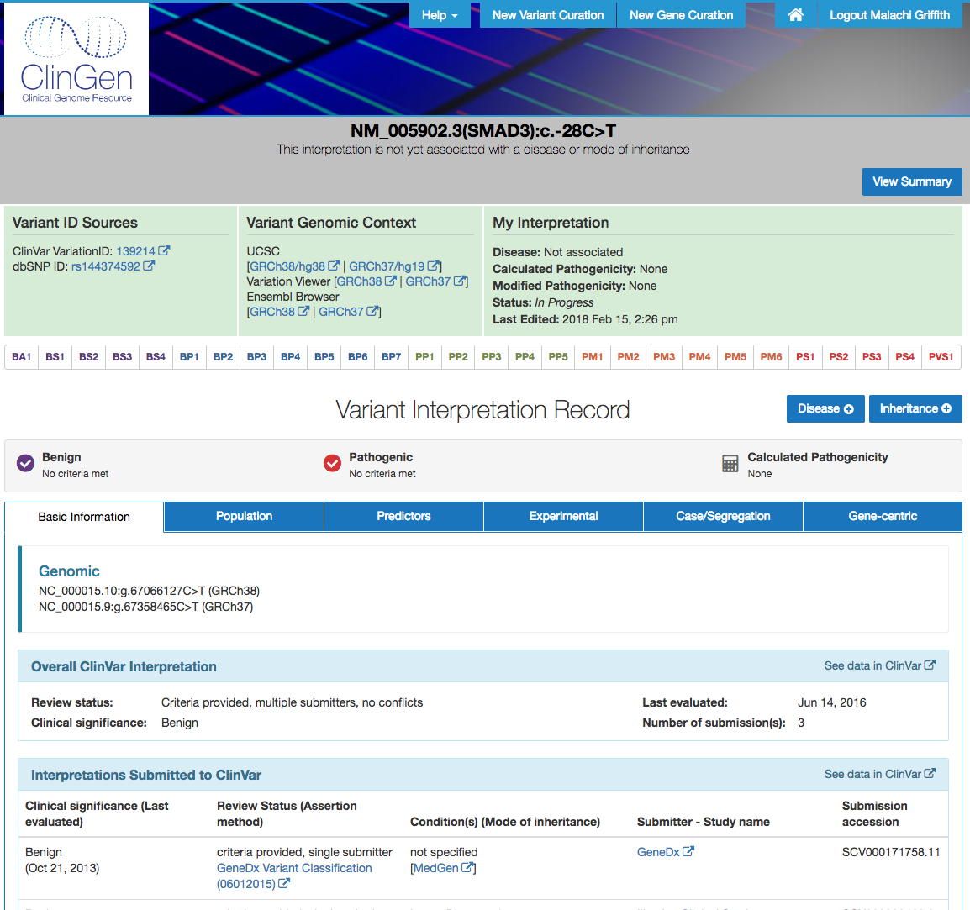
ClinGen Variant Curation Interface (VCI)
CIViC and the VCI are distinguished by their emphasis on the curation process, provenance, adherence to documented guidelines, openness, etc.

Slide 34
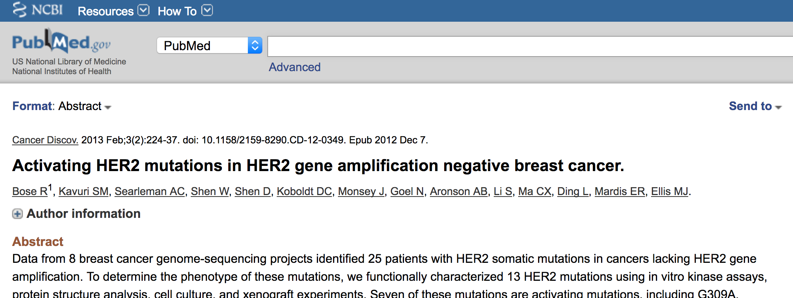
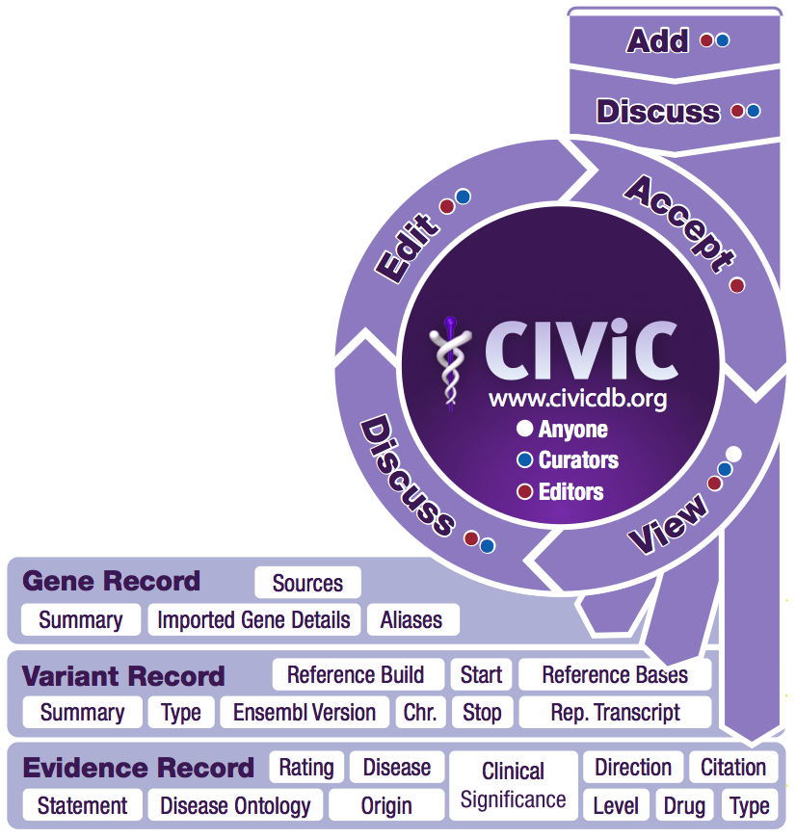
The CIViC curation cycle promotes quality, provenance and an up-to-date knowledgebase
How is quality maintained?
- Content creation is completely transparent
- Anyone can become a curator but this role has limited powers
- All content must be reviewed by a site editor or domain expert
- Users can not accept their own contributions
- Problems can be identified by comment or flag
Kilannin Krysiak
Notes:
The collaborative model of CIViC.
Data gets into CIViC when a curator identifies a clinically relevant finding in a publication and synthesizes that into a compact structured evidence item
Once edited, the new item goes into a queue where it must be reviewed and approved by an editor. Until this happens it can only be viewed by other editors and the original contributor. Automated quality checks occur at this stage to ensure that appropriate identifiers and ontologies are being used correctly. The editor also does an assessment ensures that the entry adheres to principles of CIViC.
Once approved, it can be viewed by everyone in the community.
We hope at this point a broader discussion of the evidence item may occur. If this discussion results in any edits to the evidence item, again an editor will either apply or reject those edits to the live item.
Moderators help to manage discussion. Administrators manage user accounts and help to coordinate bug fixes and improvements in the interface.
Consumers are able to see the current live state of all content. All other user types must be logged in and all of their contributions are carefully tracked.

Slide 35
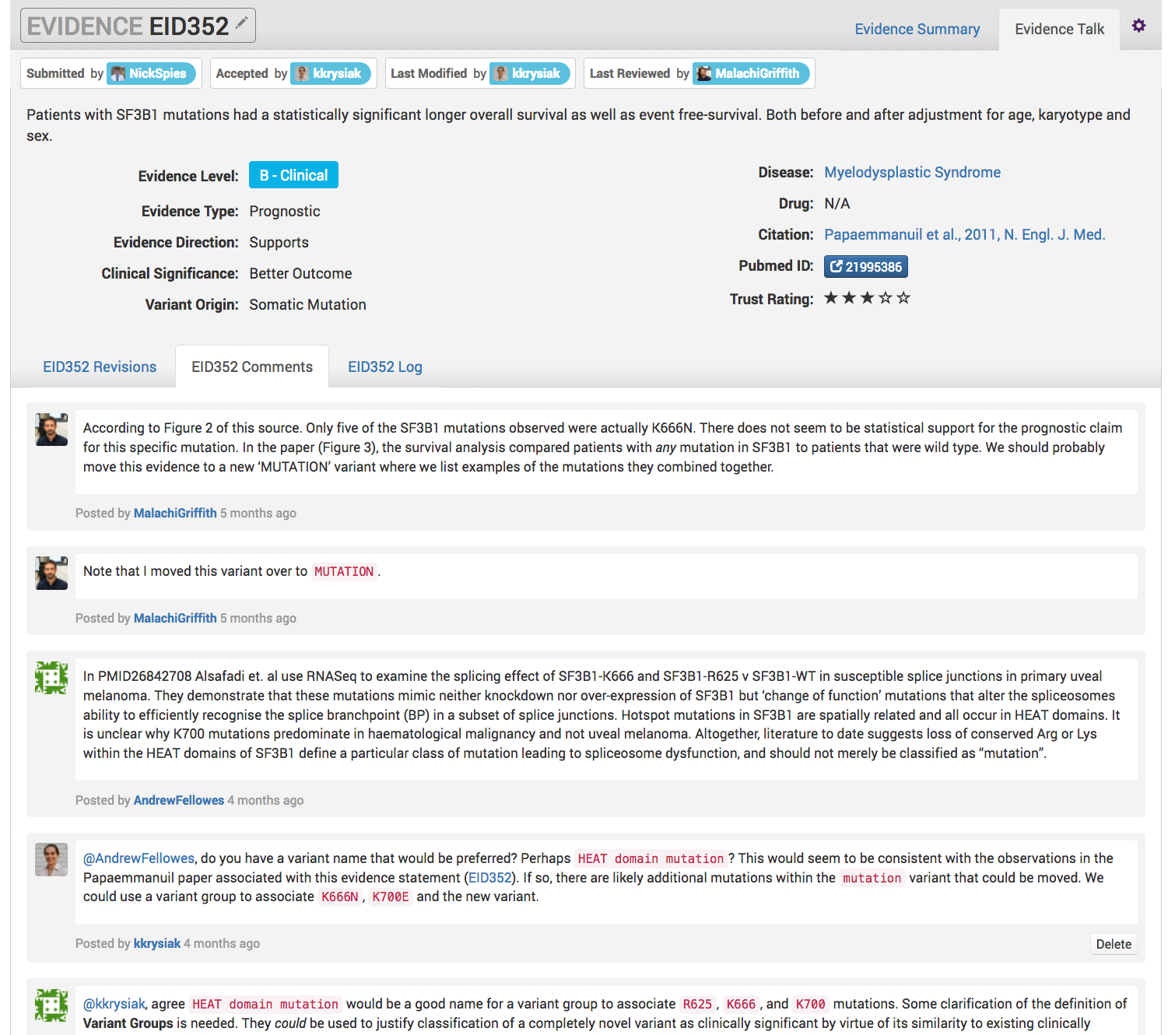
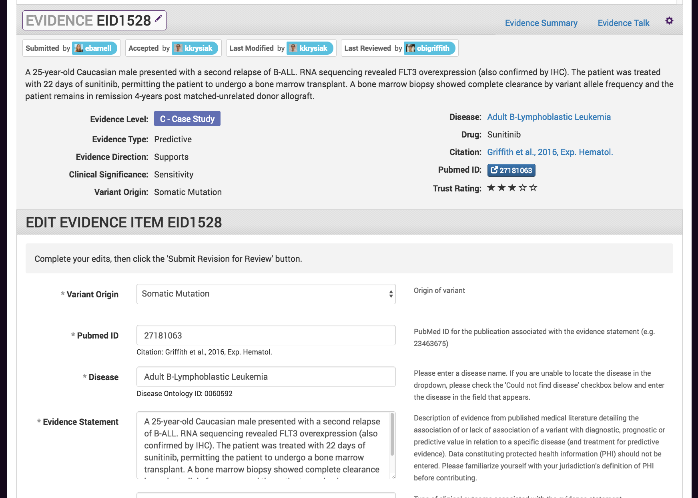
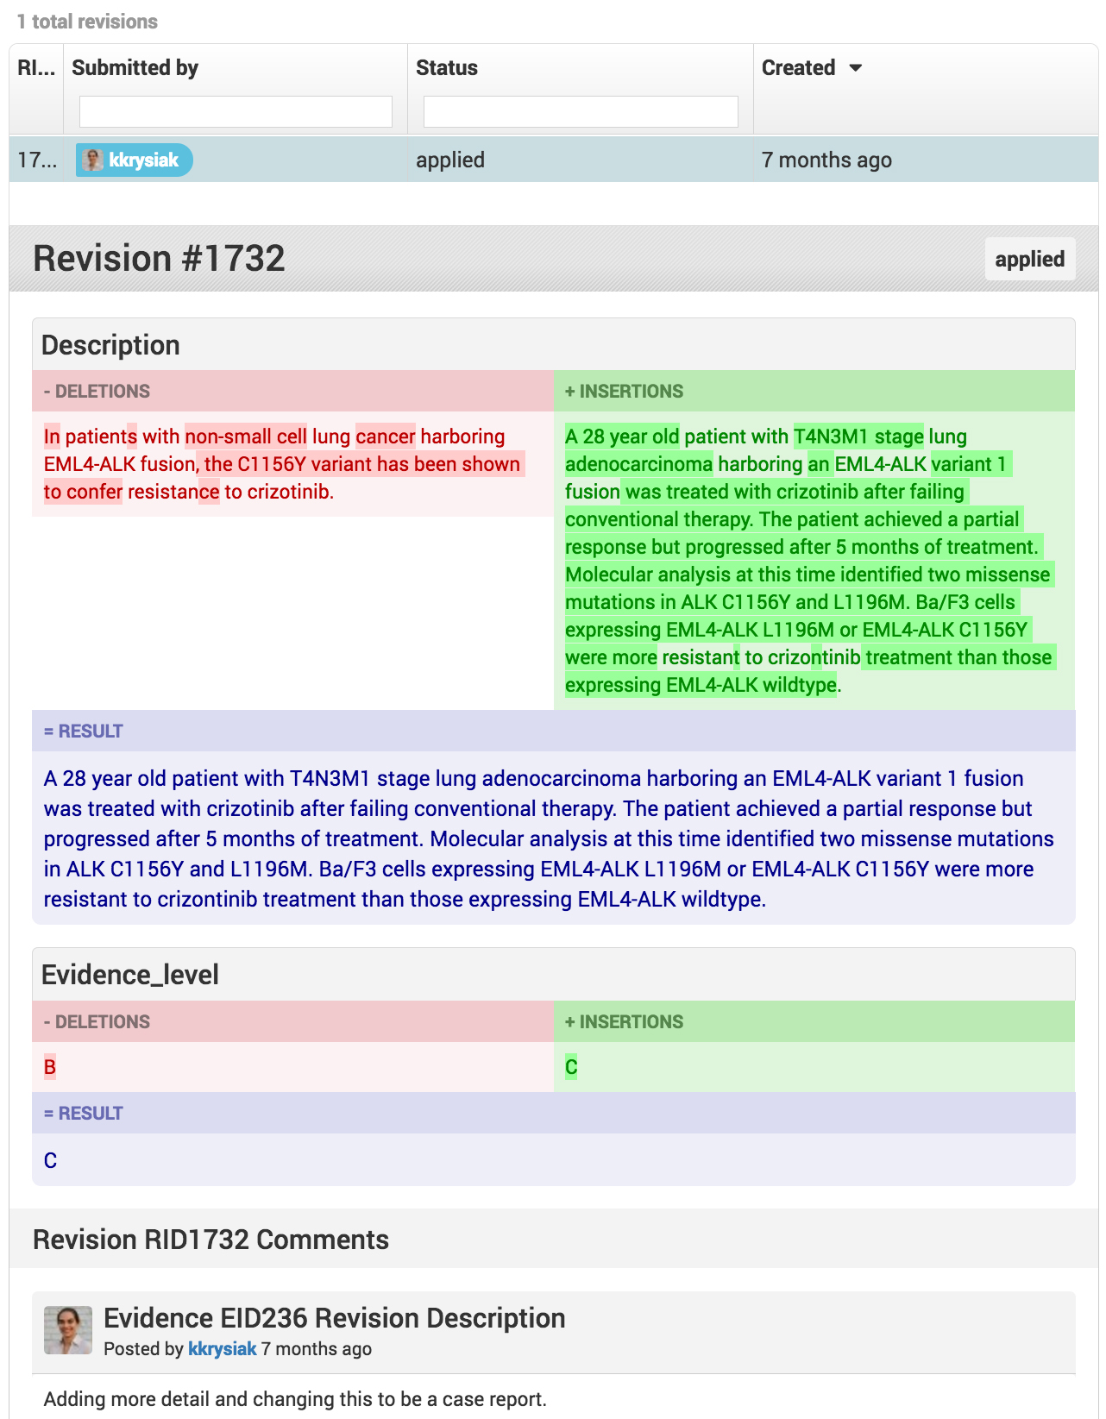
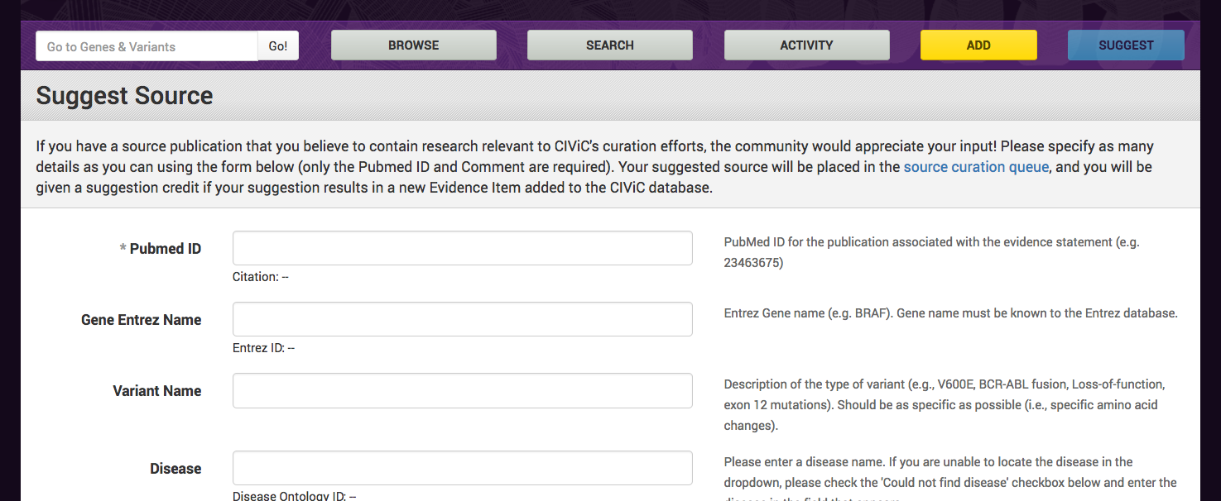
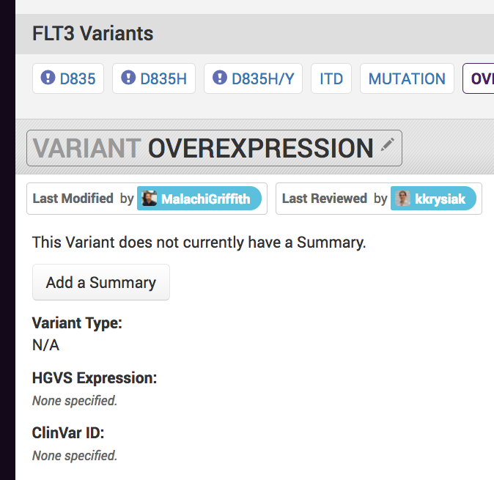
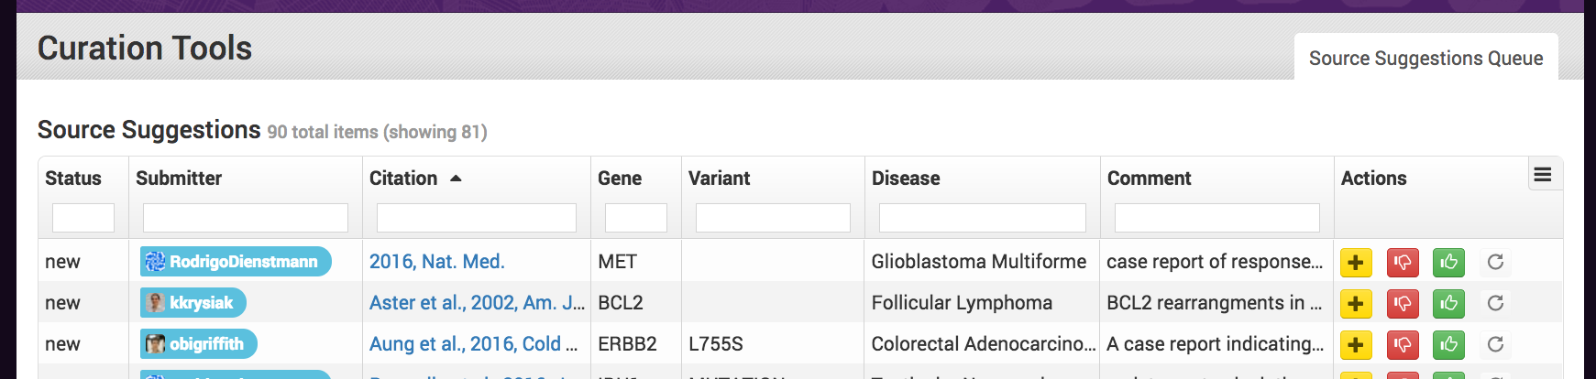
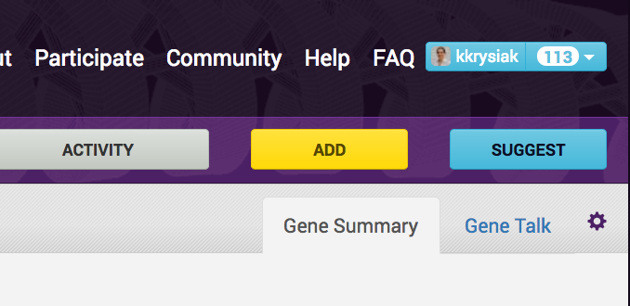
How can you participate? Visit www.civicdb.org to join as a curator
Discuss or flag
for review
Suggest
publications
Suggest
revisions
Add new
content
LOW CURATION BURDEN
HIGH CURATION BURDEN
Kilannin Krysiak

Slide 36
Strategies to bring genomics information to bear for as many cancer patients as possible
Precision medicine targeting of driver mutations
Leveraging passenger variants
Tracking minimal residual disease
Identifying neoepitopes
Predicting response to immunotherapy
Developing personalized vaccines

Slide 37
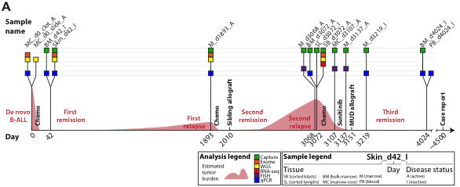
In the example leukemia (ALL) case we performed comprehensive disease tracking using bone marrow biopsies
We ultimately profiled 18 samples from nine time points (bone marrow biopsies) throughout disease progression to better understand the evolution of this tumor
Kilannin Krysiak
Notes:
The first case is ALL1. This case is ongoing now for ~13 years.
Brief case history
Age 25: Initial presentation of classic pre B-ALL. Standard induction, consolidation, and 2 years of maintenance therapy.
Age 30: 1st relapse. Complete response obtained with salvage, consolidation with a matched sibling allo transplant; very mild GvHD.
Age 33: 2nd relapse, CNS involvement. Salvage chemo reduced, but did not eliminate the tumor. A second transplant was therefore unlikely to work.
At this point we sequenced sorted blasts obtained from the 2nd relapse and attempted to find something actionable

Slide 38
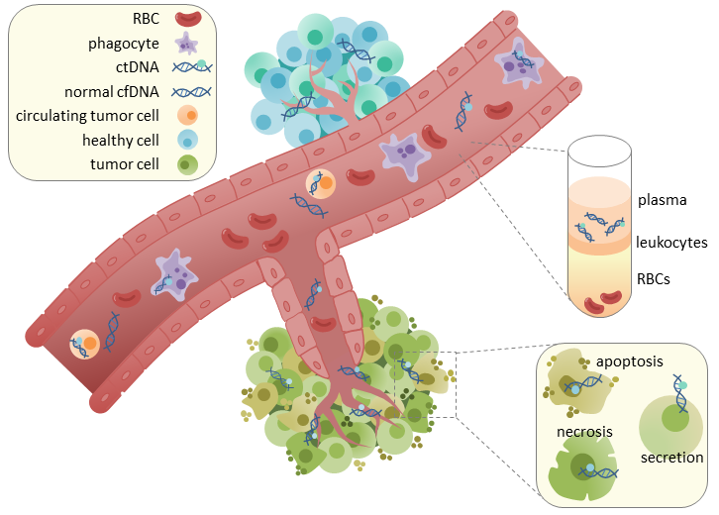
Circulating tumor DNA (ctDNA) could allow generalized tracking in any cancer type
Wikimedia Commons (CC BY-SA 4.0)
Notes:
https://en.wikipedia.org/wiki/Circulating_tumor_DNA#/media/File:CtDNA_in_circulation.png

Slide 39
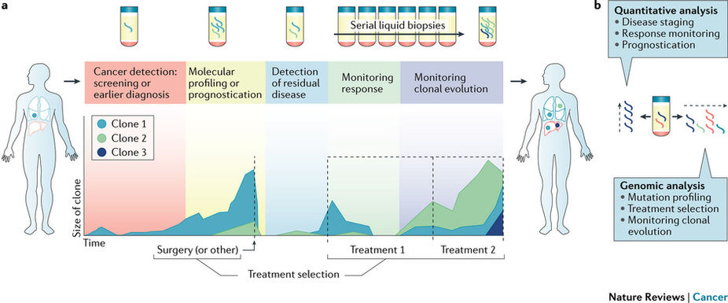
ctDNA could allow early detection, risk assessment, monitoring of response during therapy, and detection of residual disease after therapy
Wan et al. Nature Reviews Cancer volume 17, pages 223–238 (2017)

Slide 40

Preliminary ctDNA data in triple negative breast cancer
Blood for ctDNA
Blood for ctDNA
Blood for ctDNA
Blood for ctDNA every 6 months X 5 years
Research biopsy
Research biopsy
Research biopsy at surgery
DOCETAXEL AND CARBOPLATIN
ADJUVANT CHEMOTHERPY AT TREATING MDs DISCRETION
SURGERY
Stage 2/3TNBC
Tumor/ctDNA sequencing to identify mutations
Tumor/ctDNA sequencing to identify mutations
Tumor/ctDNA sequencing to identify mutations
Tumor/ctDNA sequencing to identify mutations
Clinical Trial: NCT02124902 (Contact PI: Foluso Ademuyiwa)
Notes:
- Of course doing this in blood tumors is one thing, doing it in solid tumors adds a level of difficulty.

Slide 41
Breast ctDNA preliminary data is promising
Exome sequencing of tumor tissue to discover somatic variants, followed by ultradeep targeted assay of cfDNA isolated from plasma
Yan-Yang Feng
Notes:
- pCR = pathologic complete response

